Slide 1
Lecture 1 - Introduction
Multimedia Computing

Slide 2
Scope of Multimedia Computing Courses in Today's World
Multimedia Computing is an interdisciplinary field that combines computer science, graphics, animation, audio/video processing, web technologies, artificial intelligence, virtual reality, and interactive media. With the rapid growth of digital content and emerging technologies, multimedia computing has become one of the most promising career fields.
Importance of Multimedia Computing
Modern organizations increasingly rely on multimedia technologies for communication, education, entertainment, marketing, healthcare, and business operations. The demand for professionals who can create, manage, and analyze digital content is growing worldwide.
Key Areas
Digital Media Production
Animation and Graphics Design
Web and Mobile Application Development
Game Development
Artificial Intelligence in Media
Virtual Reality (VR) and Augmented Reality (AR)
Digital Marketing and Content Creation
Human-Computer Interaction (HCI)

Slide 3
B. Graphics and Animation
Graphic Designer
2D/3D Animator
Motion Graphics Designer
Visual Effects (VFX) Artist
Digital Illustrator
C. Gaming Industry
Game Developer
Game Designer
AR/VR Developer
Interactive Media Designer
D. Media and Entertainment
Video Editor
Multimedia Producer
Content Creator
Film and Animation Specialist
E. Artificial Intelligence and Data Analytics
Computer Vision Engineer
Multimedia Data Analyst
AI Content Developer
Image and Video Processing Specialist

Slide 4
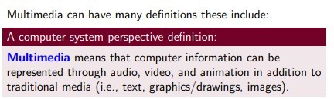
What is multimedia?

Slide 5
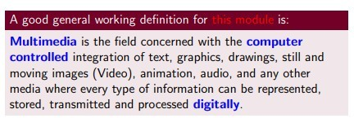
What is multimedia?

Slide 6

What is multimedia?

Slide 7
Multimedia Computing is the integration of multiple forms of digital media and computing technologies to process, manage, and communicate information effectively.
Multimedia Computing is the field of computer science that deals with the creation, processing, storage, transmission, and presentation of information in multiple media formats such as:
Text
Images
Audio
Video
Animation
Graphics
Interactive content
It combines computing technologies with digital media to create rich and interactive user experiences.

Slide 8
2. Evolution of Multimedia Computing
Early Era (1960s–1980s)
Text-based computer systems
Limited graphics capability
No multimedia integration
Multimedia Era (1990s)
Introduction of CDs and DVDs
Audio and video playback
Interactive educational software
Modern Era (2000–Present)
High-speed internet
Streaming services
Virtual Reality (VR)
Artificial Intelligence (AI)
Augmented Reality (AR)
Cloud Computing

Slide 9
Multimedia System Characteristics
A multimedia system should provide:
Integration
Different media types work together.
Interactivity
Users can interact with content.
Digital Representation
All media are stored digitally.
Synchronization
Audio and video remain aligned.
Example
Online Zoom classes synchronize:
Video
Audio
Text chat
Screen sharing

Slide 10
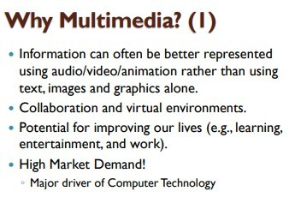
Why multimedia?

Slide 11
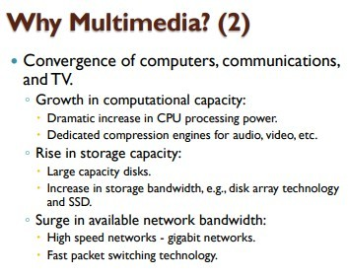
Why multimedia?

Slide 12
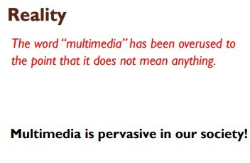
Why multimedia?

Slide 13
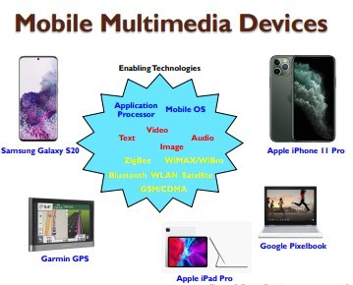
Why multimedia?

Slide 14
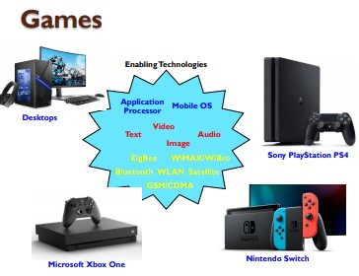
Why multimedia?

Slide 15
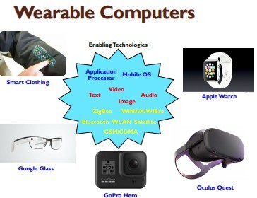
Why multimedia?

Slide 16
Why multimedia?

Slide 17
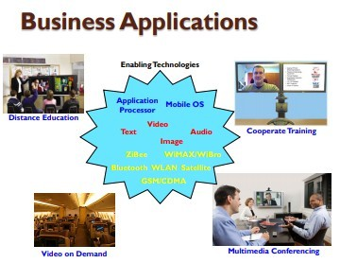
What is multimedia?

Slide 18
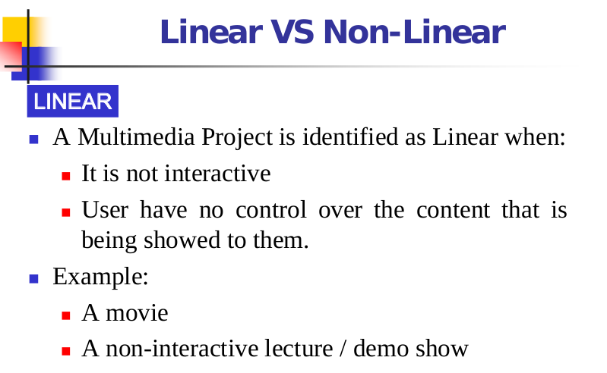
What is multimedia?

Slide 19
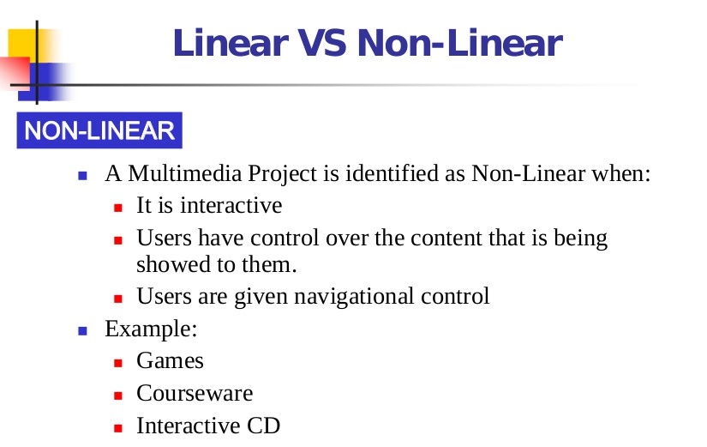
What is multimedia?

Slide 20
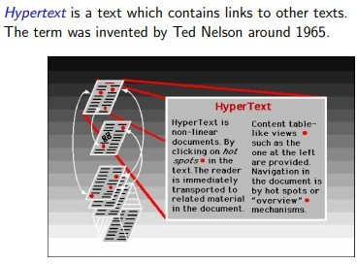
Hypertext

Slide 21
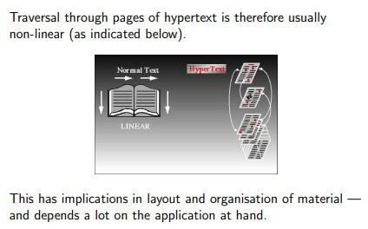
Hypertext

Slide 22
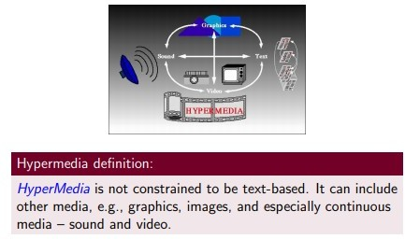
Hypermedia

Slide 23
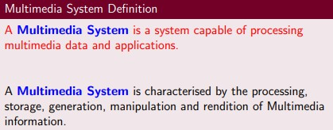
Multimedia System

Slide 24
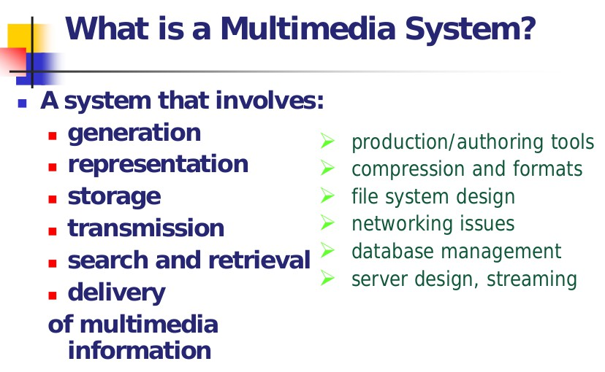
Multimedia System

Slide 25
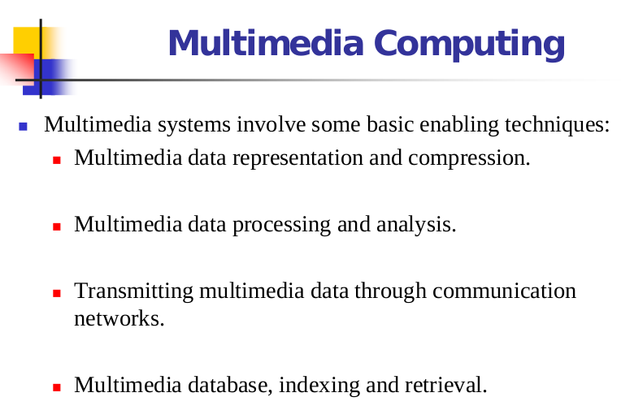
Multimedia System

Slide 26
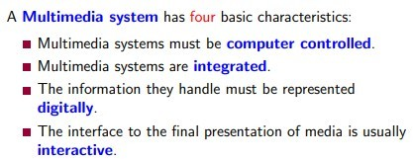

Slide 27
Challenges of Multimedia Computing
Challenges of Multimedia Computing Multimedia Computing combines text, images, audio, video, animation, graphics, and interactive technologies to create, process, store, and transmit digital content. Although it has revolutionized communication, education, entertainment, healthcare, and business, it also faces several technical, economic, security, and ethical challenges.

Slide 28
Large Data Storage
Huge files
Storage cost
Cloud storage
Compression
Multimedia files such as high-definition (HD), 4K, and 8K videos, high-resolution images, and 3D models require significant storage capacity.
Challenges
Large file sizes
Increased storage costs
Backup and recovery complexity
Efficient database management
Example
A one-hour 4K video can occupy 20–50 GB depending on the compression format.

Slide 29
Bandwidth
Multimedia applications require fast and reliable networks to transmit large amounts of data.
Challenges
Slow internet speeds
Network congestion
Buffering during video streaming
Packet loss
Example
Live video conferencing requires stable bandwidth to maintain video and audio quality.

Slide 30
Compression
Efficient compression is essential to reduce storage requirements and transmission time while maintaining acceptable quality.
Challenges
Balancing compression ratio and quality
Compression artifacts
Increased processing time
Common Compression Standards
Images: JPEG, PNG, WebP
Audio: MP3, AAC
Video: H.264, H.265 (HEVC), AV1

Slide 31
Real-Time Processing
Many multimedia applications require immediate processing and delivery.
Applications
Video conferencing
Online gaming
Live broadcasting
Virtual Reality (VR)
Challenges
Low latency
Synchronization
High computational requirements

Slide 32
Synchronization
Audio and video streams must remain synchronized during playback.
Challenges
Network delays
Buffering
Clock synchronization errors
Example
A speaker's lips move before the audio is heard.

Slide 33
Security
Multimedia data often contains sensitive personal and organizational information.
Security Issues
Unauthorized access
Data theft
Copyright infringement
Piracy
Malware attacks

Slide 34
Copyright
Protecting digital content from unauthorized copying and distribution is increasingly difficult.
Challenges
Illegal downloads
Content piracy
Copyright violations
Unauthorized sharing
Solutions
Digital watermarking
Copyright management systems
Licensing agreements

Slide 35
AI integration
AI enhances multimedia systems but introduces new complexities.
Challenges
Large training datasets
High computational costs
Model bias
Ethical concerns
Explainability of AI decisions
Applications
Image recognition
Speech recognition
Video analytics
Generative AI

Slide 36
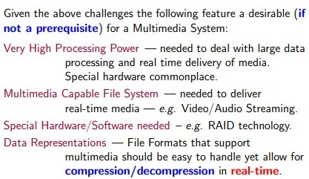
Desirable Features

Slide 37
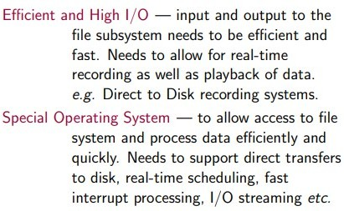
Desirable Features

Slide 38
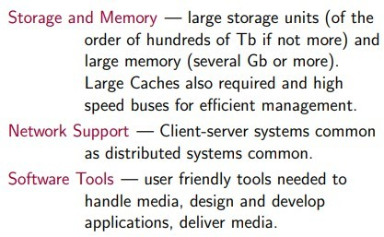
Desirable Features

Slide 39
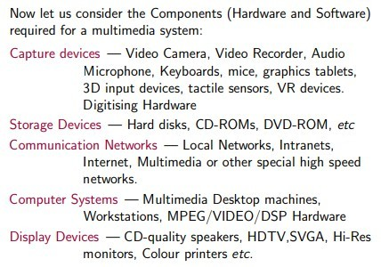
Components

Slide 40
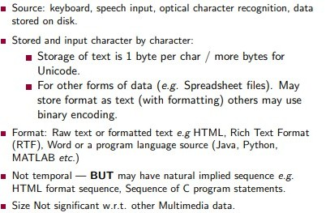
Text

Slide 41
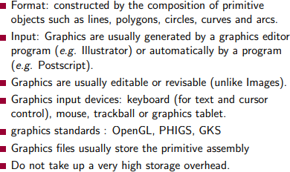
Graphics

Slide 42
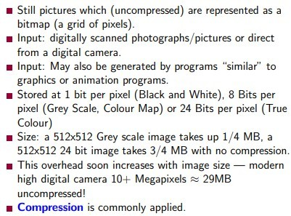
Image

Slide 43
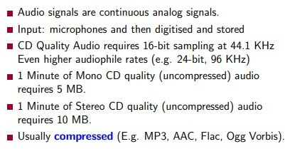
Audio

Slide 44
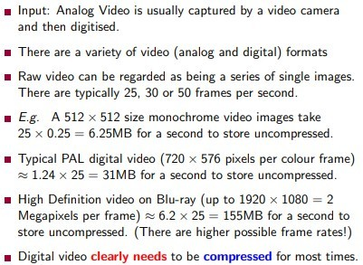
Video

Slide 45
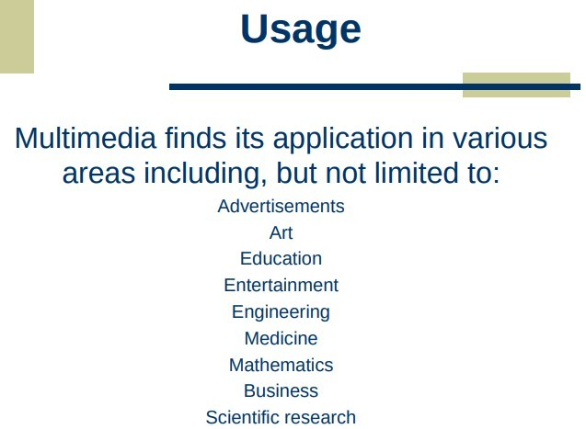
What is multimedia?

Slide 46
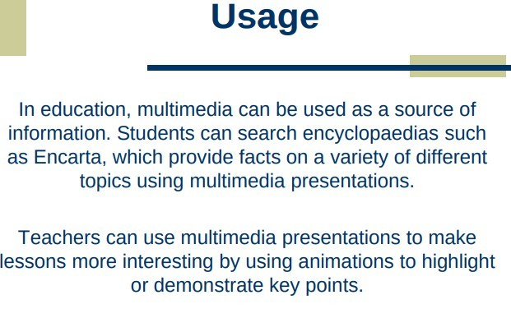
What is multimedia?

Slide 47
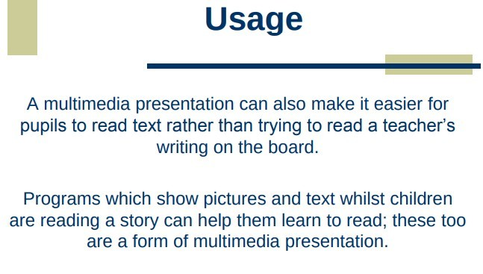
What is multimedia?

Slide 48
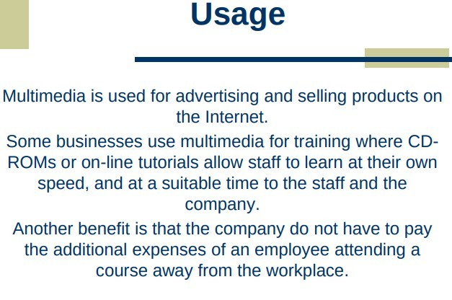
What is multimedia?

Slide 49
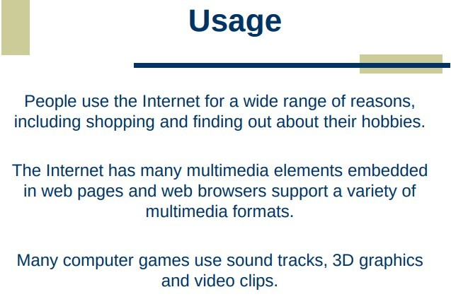
What is multimedia?

Slide 50
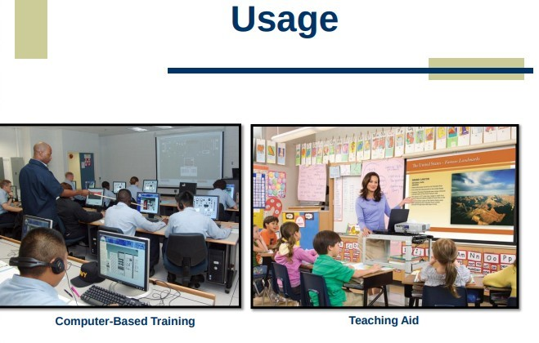
What is multimedia?

Slide 51
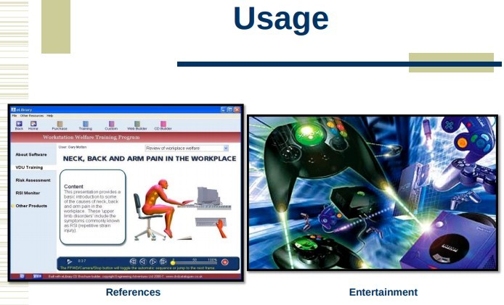
What is multimedia?

Slide 52
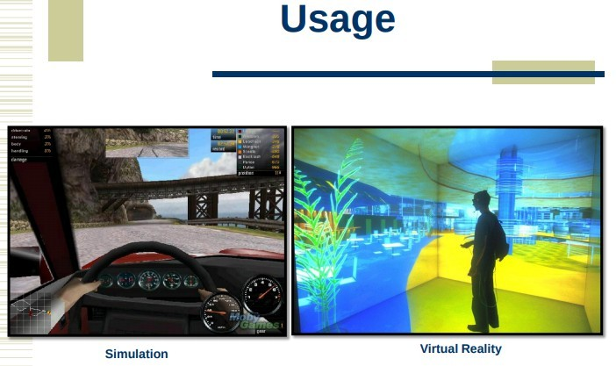
What is multimedia?

Slide 53
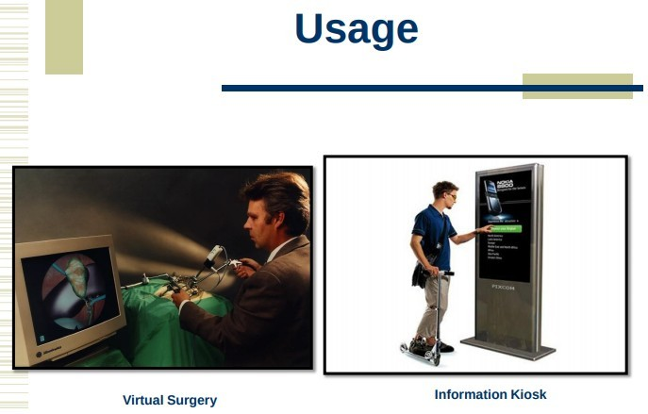
What is multimedia?

Slide 54

What is multimedia?

Slide 55
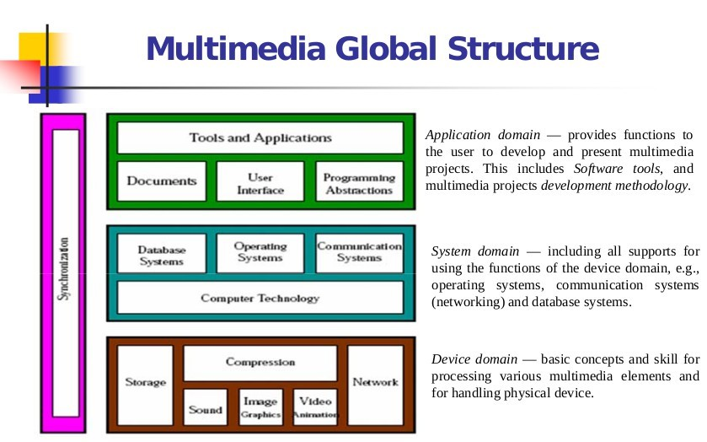
What is multimedia?

Slide 56
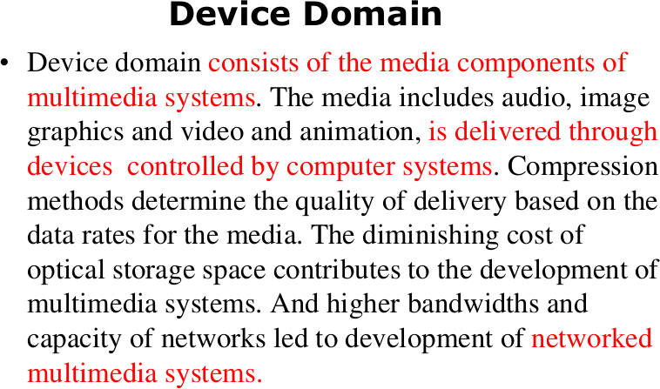

Slide 57
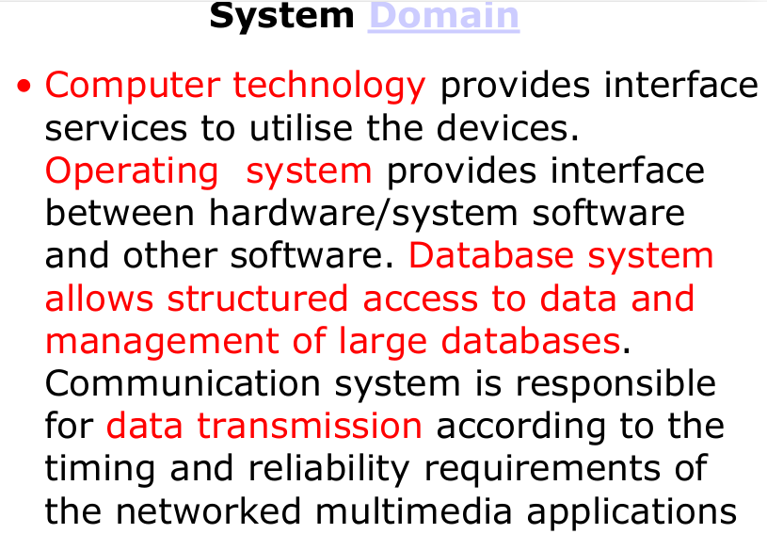

Slide 58
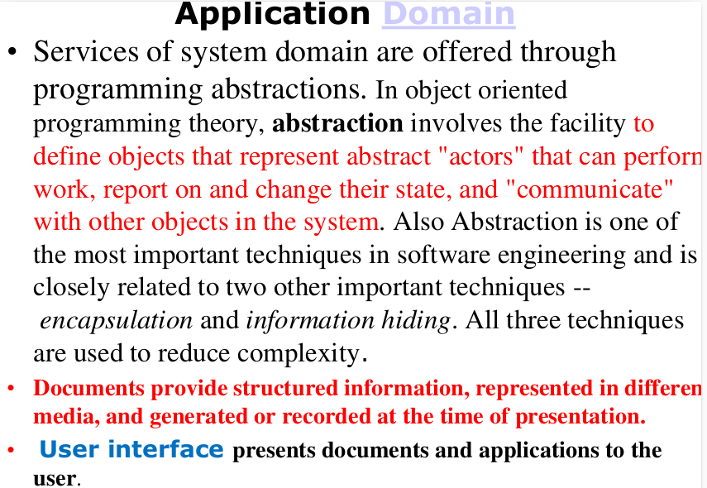

Slide 59
